Slide 1
Science Safety
Safety Rules
Safety Contract

Slide 2
Science Notebooks
Decorate the first page of your journal.
Create a Table of Contents for the 1st Six Weeks.
Number the pages.
Science notebooks help to organize observations, data and learning.

Slide 3
It is important to protect ourselves and others as we explore and investigate in science.

Slide 4
What are the five sense?

Slide 5
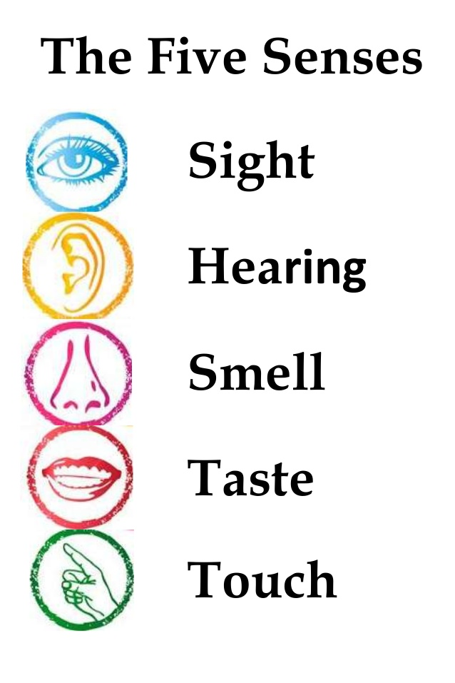
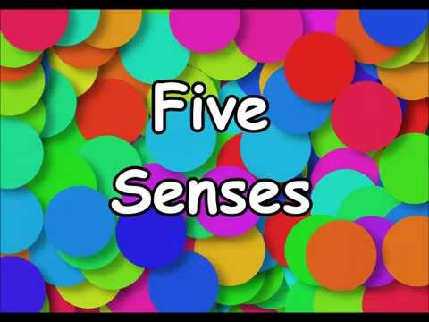

Slide 6
Why is it important to protect these senses during science investigations?

Slide 7
How do our five senses help to keep us safe?

Slide 8
Students need to sign the safety contract. Glue into your science journal.
Read over the Science Safety Contract together as a class.

